Slide 1

Data warehouse and Data mining
Name : jannatul ferdous nishi
Id :19-40374-1

Slide 2
clustering
What is clustering?
Cluster analysis or clustering is the task of grouping a set of objects in such a way that objects in the same group are more similar (in some sense) to each other than to those in other groups.

Slide 3
Types of Clustering Methods
The various types of clustering are:
Connectivity-based Clustering (Hierarchical clustering)
Centroids-based Clustering (Partitioning methods)
Distribution-based Clustering
Density-based Clustering (Model-based methods)
Fuzzy Clustering
Constraint-based (Supervised Clustering)

Slide 4

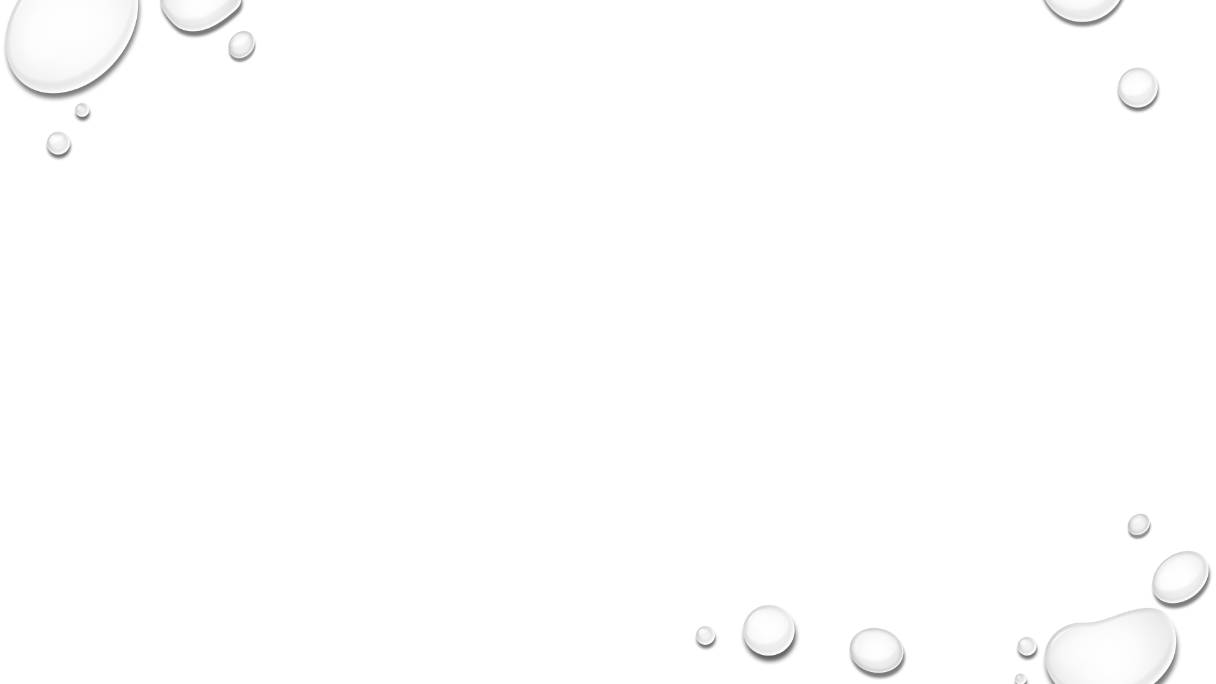
CONNECTIVITY BASED CLUSTERING(HIERARCHICAL CLUSTERING)
Hierarchical Clustering is a method of unsupervised machine learning clustering where ins with a pre-defined top to bottom hierarchy of clusters.
Hierarchical clustering can be divided into two main types:
agglomerative
divisive

Slide 5
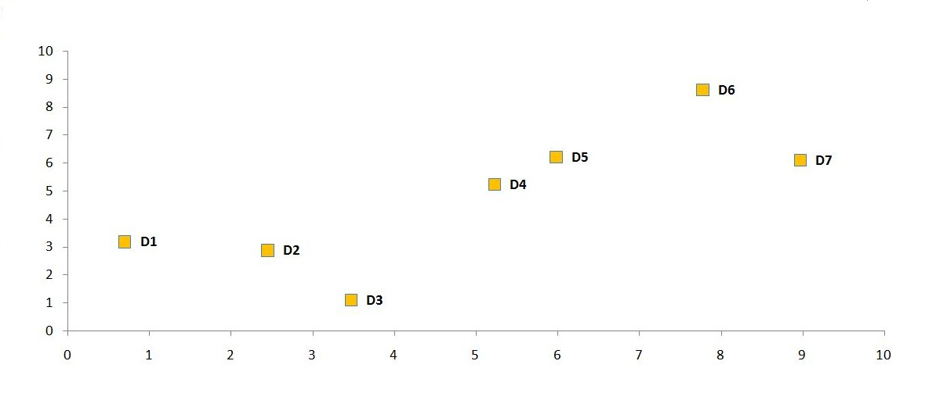
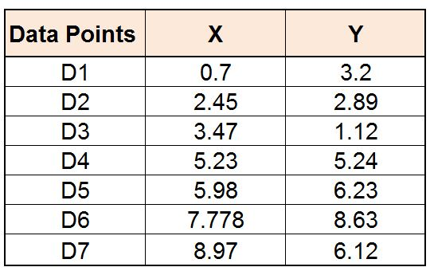
Agglomerative clustering

Slide 6
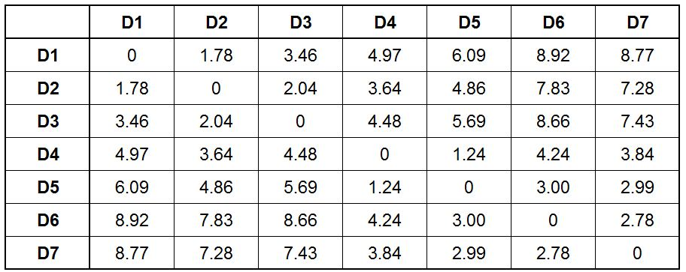
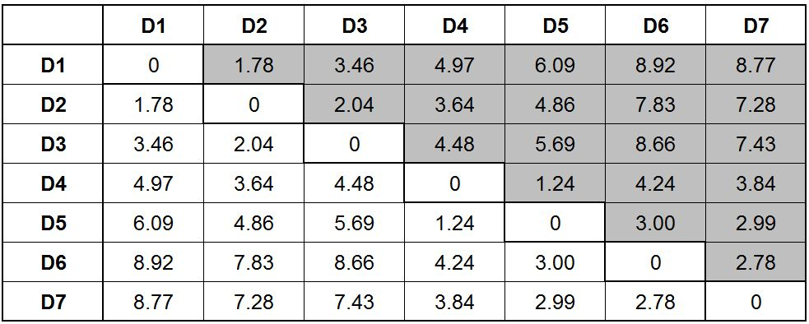
Steps for Performing Agglomerative Hierarchical Clustering
STEP 1

Slide 7
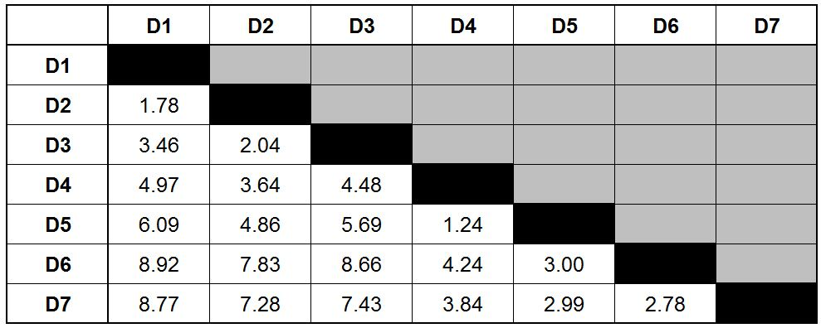
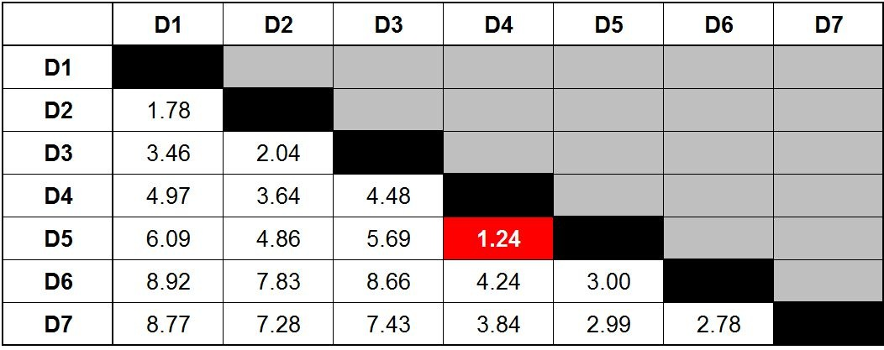
STEP 2

Slide 8
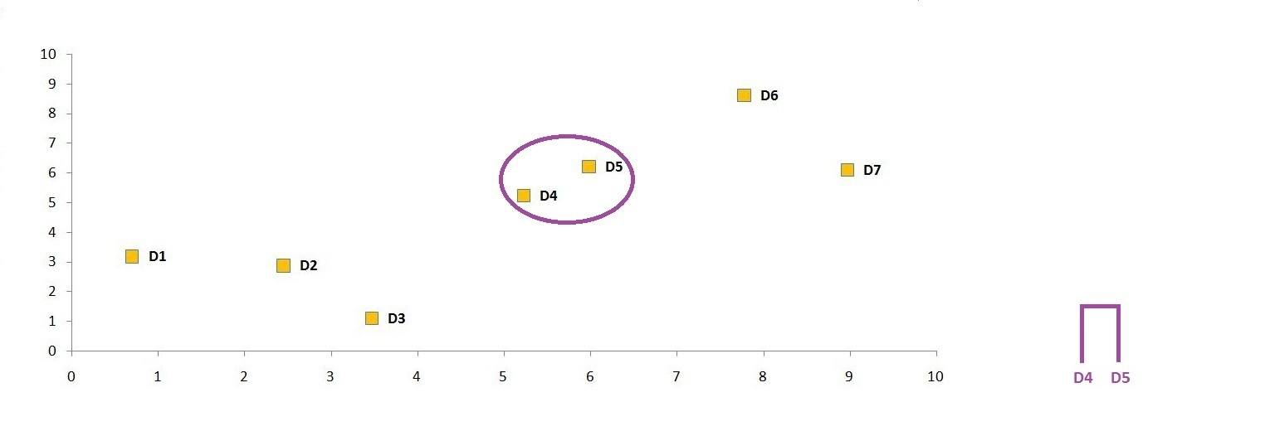
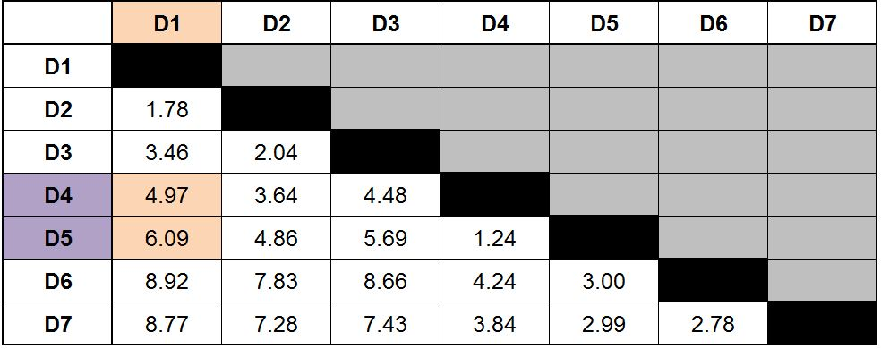
STEP 3

Slide 9
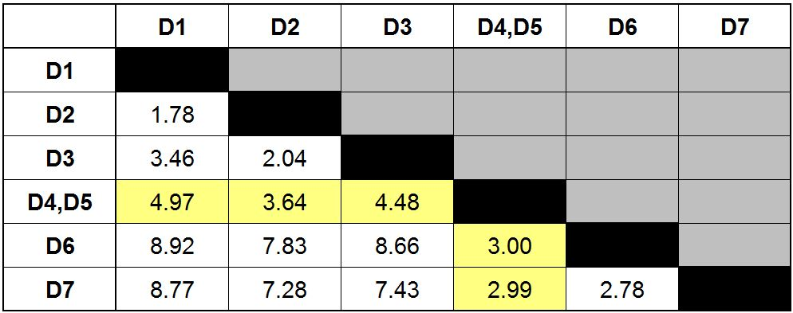
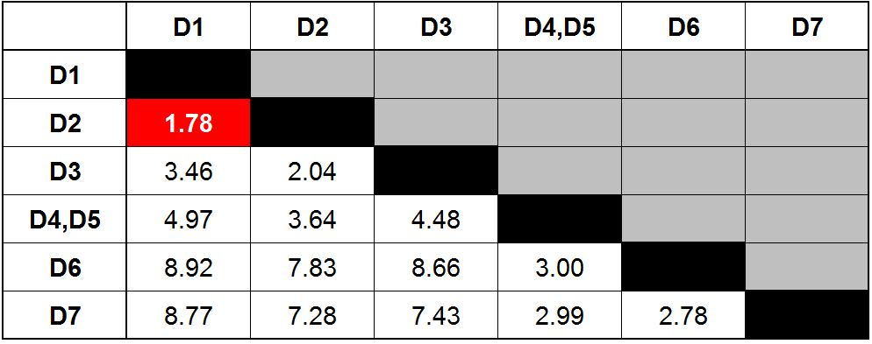
STEP 4

Slide 10
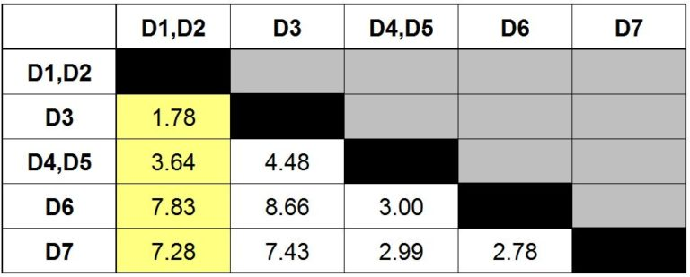
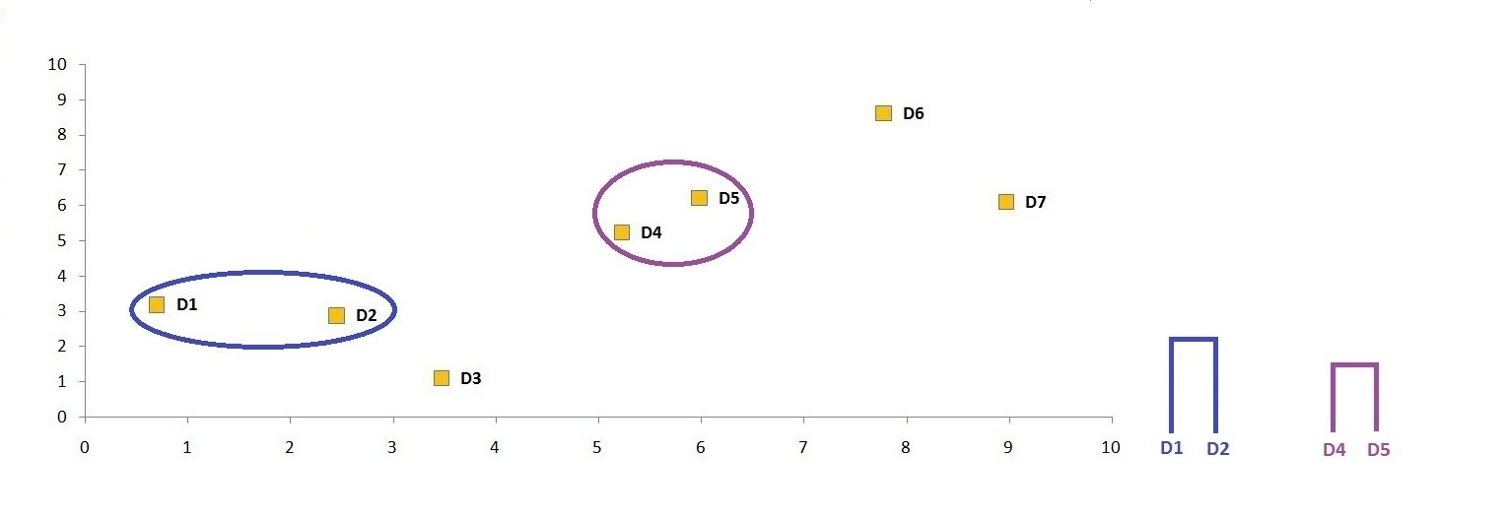
STEP 5

Slide 11
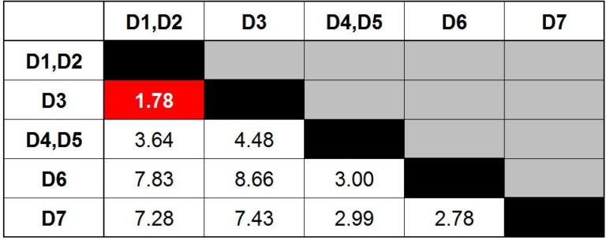
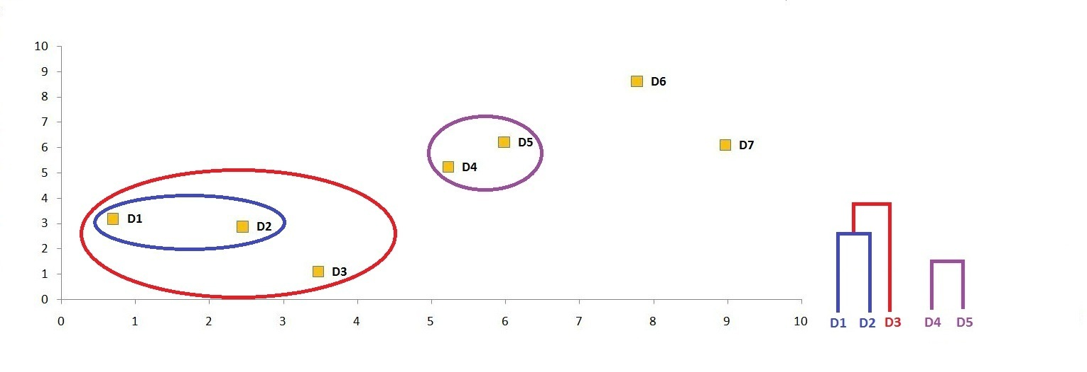
STEP 6

Slide 12
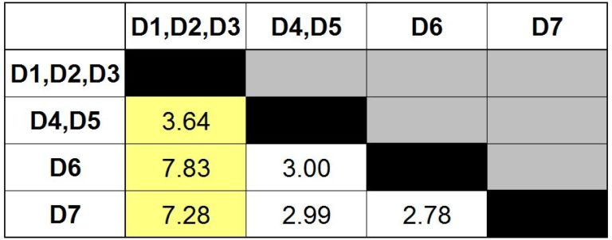
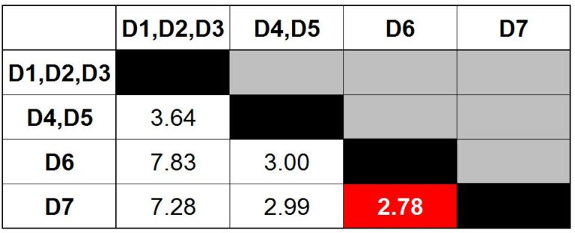
STEP 7

Slide 13
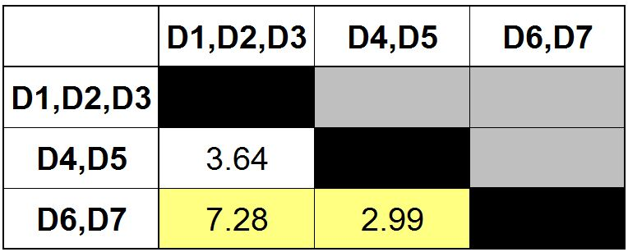
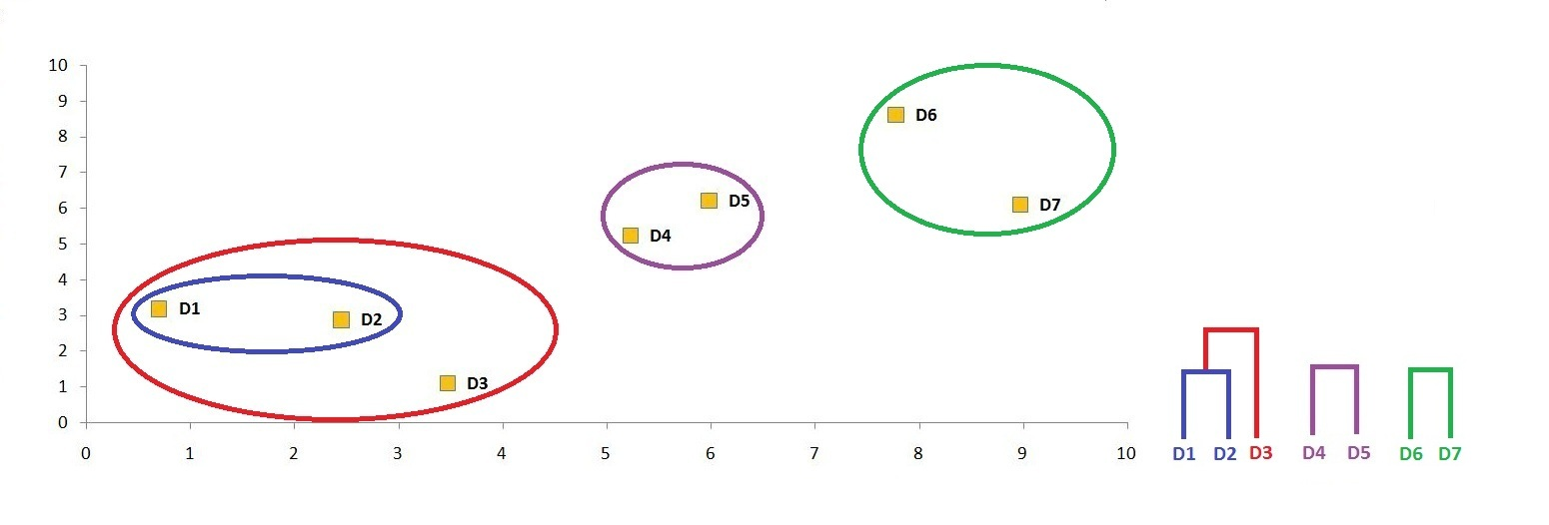
STEP 9

Slide 14
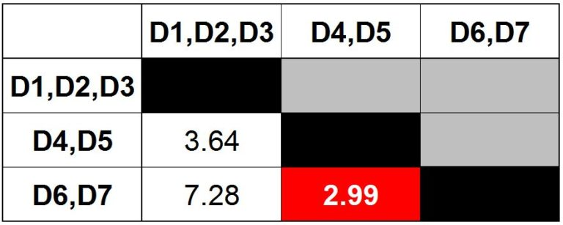
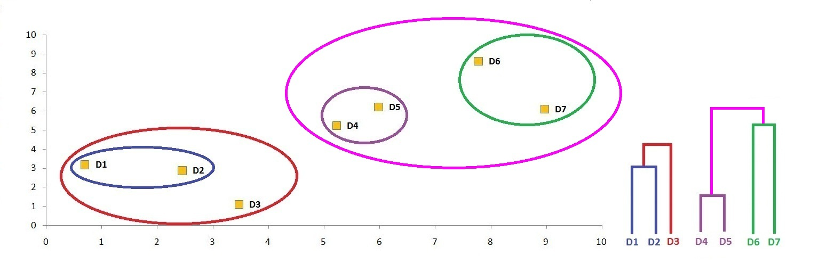
STEP 1O

Slide 15
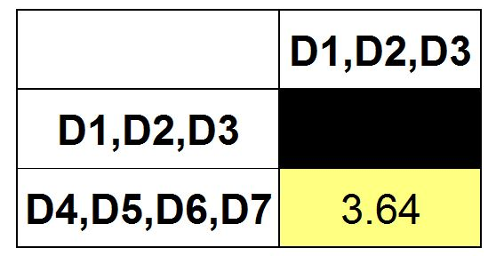
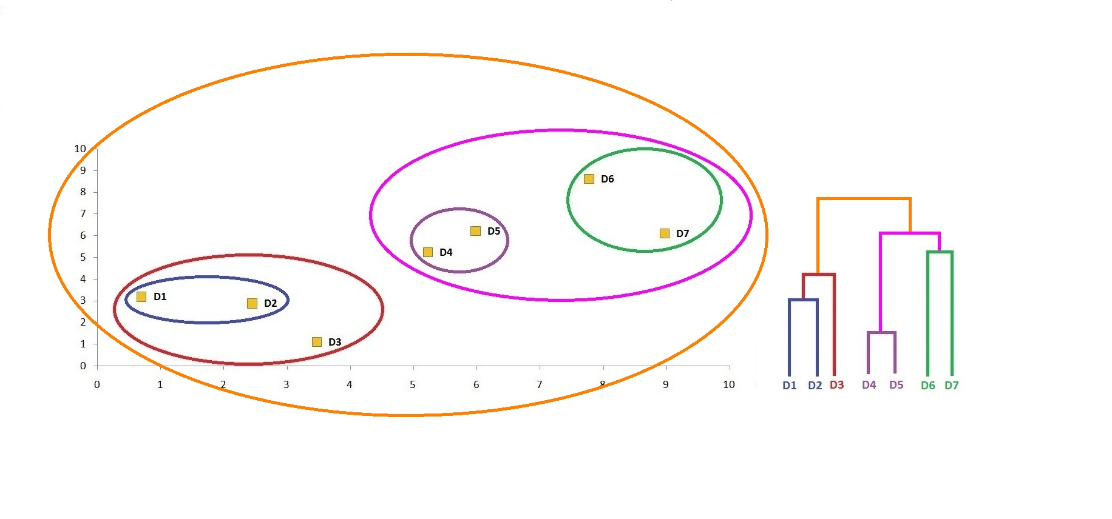
STEP 11

Slide 16
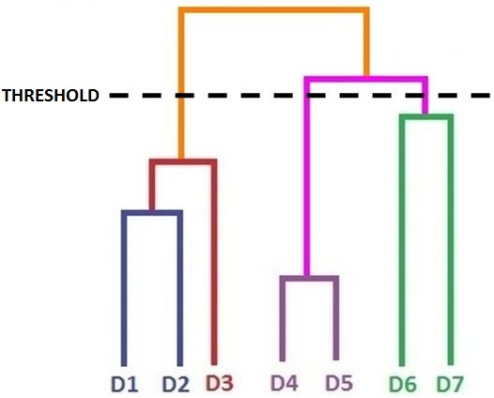
Thus, we are finally able to come up with a single cluster

Slide 17
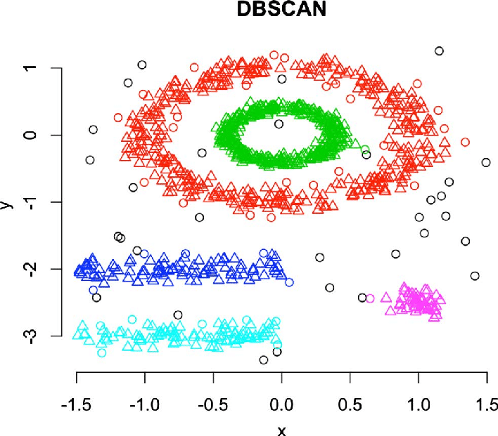
Distribution-Based Clustering
The clustering techniques as we know are based around either proximity (similarity/distance) or composition (density).

Slide 18
The DBSCAN algorithm uses two parameters:
Min Pts: The minimum number of points (a threshold) clustered together for a region to be considered dense.
eps (ε): A distance measure that will be used to locate the points in the neighborhood of any point.

Slide 19
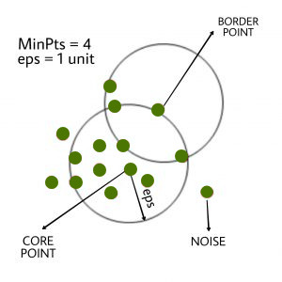
in this algorithm, we have 3 types of data points. Core Point: A point is a core point if it has more than MinPits points within eps. Border Point: A point which has fewer than Min Pts within eps but it is in the neighborhood of a core point. Noise or outlier: A point which is not a core point or border point.

Slide 20
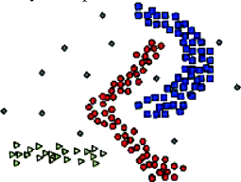
Density-based Clustering
Density-based algorithms can get us clusters with arbitrary shapes, clusters without any limitation in cluster sizes, clusters that contain the maximum level of homogeneity by ensuring the same levels of density within it, and also these clusters are inclusive of outliers or the noisy data.

Slide 21

THANK YOU

